Slide 1
SIT113 Cloud Computing and Virtualisation
Week 9, Class 2
Working with Clouds

Slide 2
Outline
Working with Clouds
Business Cost Metrics (Chapter 15)
Cloud Usage Cost Metrics (Chapter 15)
Cost Management Considerations (Chapter 15)

Slide 3
Business Cost Metrics
Leasing cloud resources versus on-premise:
Up-Front Costs
On-Going Costs
Additional Business Costs

Slide 4
Business Cost Metrics
Up-Front Costs
Initial investment to fund resources, including:
Acquisition
Deployment
Administration
On-premise costs tend to be high (hardware, software, and labour)
Cloud-based IT resources costs tend to be low (labour to assess and setup cloud environment)

Slide 5
Business Cost Metrics
On-Going Costs
Expenses to run and maintain IT resources
On-premise costs can vary (licensing fees, electricity, insurance, labour)
Cloud-based costs can exceed on-premise costs over a long period of time (virtual hardware leasing fees, licensing fees, bandwidth usage fees, and labour)

Slide 6
Business Cost Metrics
Additional Business Costs
Cost of Capital:
cost for raising required funds, e.g., loans, (helps justify leasing cloud-based resources)
Sunk Costs*:
Available on-premise IT resources that have been purchased make it difficult to justify leasing cloud-based resources
* Should not be part of costs for a new project.

Slide 7
Business Cost Metrics
Integration Costs:
Integrating existing IT resources with the cloud environment, reduces the appeal of cloud-based IT resources
Locked-in Costs:
moving from one cloud provider to another (incompatible) cloud provider, decreases the long-term business value of cloud-based IT resources

Slide 8
Cloud Usage Cost Metrics
Example metrics/costs for cloud-based IT resources:
Network metrics/costs
Server usage metrics/cost
Cloud Storage Device metrics/costs
Cloud Service metrics/costs

Slide 9
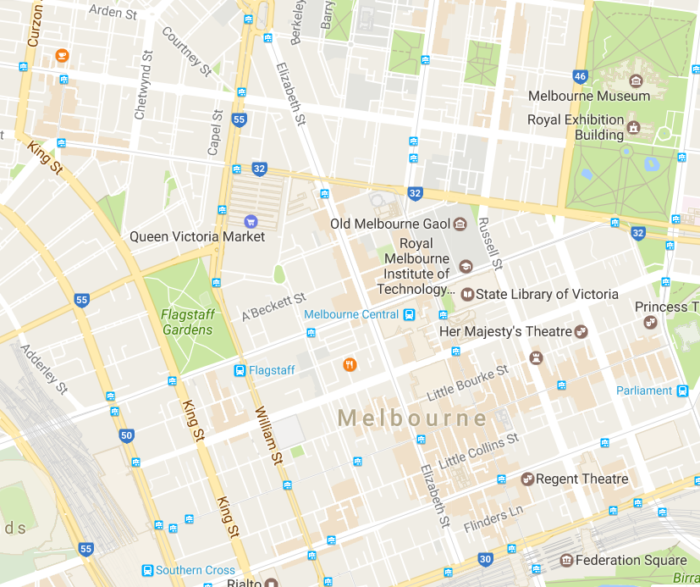

Slide 10
Cloud Usage Cost Metrics
Network metrics/costs
Network Usage Metric inbound/outbound traffic
Measured in bytes
Continuous and Cumulative over predefined period
IaaS/PaaS/SaaS
Example
up to 1GB free
$0.001/GB up to 10TB a month

Slide 11
Cloud Usage Cost Metrics
Intra-Cloud WAN Usage Metric
Measured in bytes
Continuous and Cumulative over predefined period
IaaS/PaaS/SaaS
Example
up to 500MB free daily and
$0.01/GB after 500MB
$0.005/GB after 1TB per month
Notes:
intra = within

Slide 12
Cloud Usage Cost Metrics
Other
Static IP Address Usage
Network Load-Balancing
Virtual Firewall

Slide 13
Cloud Usage Cost Metrics
Server usage metrics/cost
On-Demand VM Instance Allocation Metric
Measured by start to stop time (uptime)
Continuous & cumulative over predefined period
IaaS/PaaS
Example
$0.10/hour small instance (??? per year)
$0.20/hour medium instance
$0.90/hour large instance

Slide 14
Cloud Usage Cost Metrics
Reserved VM Instance Allocation Metric
Upfront cost and pay-per-use
Measured by reservation start to expiry date
Daily/monthly/yearly
IaaS/PaaS
Example
$60/small instance/year and $0.05/hour
$100/medium instance/year and $0.10/hour
$250/large instance/year and $0.20/hour

Slide 15
Cloud Usage Cost Metrics
Other
Measures for performance capabilities:
CPU
RAM
dedicated storage

Slide 16
Cloud Usage Cost Metrics
Cloud Storage Device metrics/costs
On-Demand Storage Space Allocation Metric
Measured using size and period, date of storage allocation to date of storage release/reallocation
Continuous
IaaS/PaaS/SaaS
Example
$0.01/GB per hour

Slide 17
Cloud Usage Cost Metrics
I/O Data Transferred Metric
Measured in bytes of I/O data
Continuous
IaaS/PaaS
Example
$0.10/TB

Slide 18
Cloud Usage Cost Metrics
Cloud Service metrics/costs
Application Subscription Duration Metric
Measured by subscription start date to expiry date
Daily/monthly/yearly
SaaS
Example
$69.90 per month

Slide 19
Cloud Usage Cost Metrics
Number of Nominated Users Metric
Measured in number of users
Monthly/yearly
SaaS
Example
$0.90/additional user per month

Slide 20
Cloud Usage Cost Metrics
Number of Transactions Metric
Measured in number of transactions (request-response message exchanges)
Continuous
PaaS/SaaS
Example
$0.05 per 1,000 transactions

Slide 21
Cost Management Considerations
Lifecycle of Cloud Services
Influences on Pricing Models
Pricing Model Dependencies

Slide 22
Cost Management Considerations
Lifecycle of Cloud Services
Cloud Service Design
Cloud Service Development
Cloud Service Deployment
implementing data collection for usage and billing
Cloud Service Contracting
cloud consumer and provider negotiations

Slide 23
Cost Management Considerations
Cloud Service Offering
cloud service’s pricing models
Cloud Service Provisioning
impact of thresholds
Cloud Service Operation
usage produces usage cost data
Cloud Service Decommissioning
archiving of cost data to identify usage and financial trends

Slide 24
Cost Management Considerations
Influences on Pricing Models
Market competition
Regulatory requirements
Overheads
incurred during the life of the cloud service

Slide 25
Cost Management Considerations
Reduce expenses
share resources
data centre optimisation
Negotiation
cost = f(quantity, quality, duration, …)

Slide 26
Cost Management Considerations
Pricing Model Dependencies
Cost Metrics and Associated Prices
on-demand versus reserved resources
Fixed and Variable Rates
Volume Discounts
Cost and Price Customisation Options
payment options and schedules

Slide 27
Cost Management Considerations
Cloud Delivery Model
IaaS: allocation and usage
PaaS: network data, virtual servers, storage
SaaS: cloud service consumers, transactions, application modules

Slide 28
Summary
Working with Clouds
Business Cost Metrics (Chapter 15)
Cloud Usage Cost Metrics (Chapter 15)
Cost Management Considerations (Chapter 15)

